Slide 1
uric acid
pyruvate,3phosphoglycerate,PEP
glycolysis
PPP
ATP
GTP
oxaloacetate
TCA
amino acid
α-ketoglutarate
carbon skeleton of glucogenic amino aicd
PRPP
for:histidine
dNTP
fumarate
glutamte,glutamine,aspartate
urea cycle
ketogenic aminno acid
CTP
UTP
aspartate,glutamate,glycine
ketone body
urea

Slide 2
catabolism of amino acids and nucleotides
pyrimidine
purine
α-ketoglutarate
amino acids
ketone bodies
amino transferase
pyruvate or TCA intermediate
glutamate
α-keto acids
UREA CYCLE
urea
uric acid

Slide 3
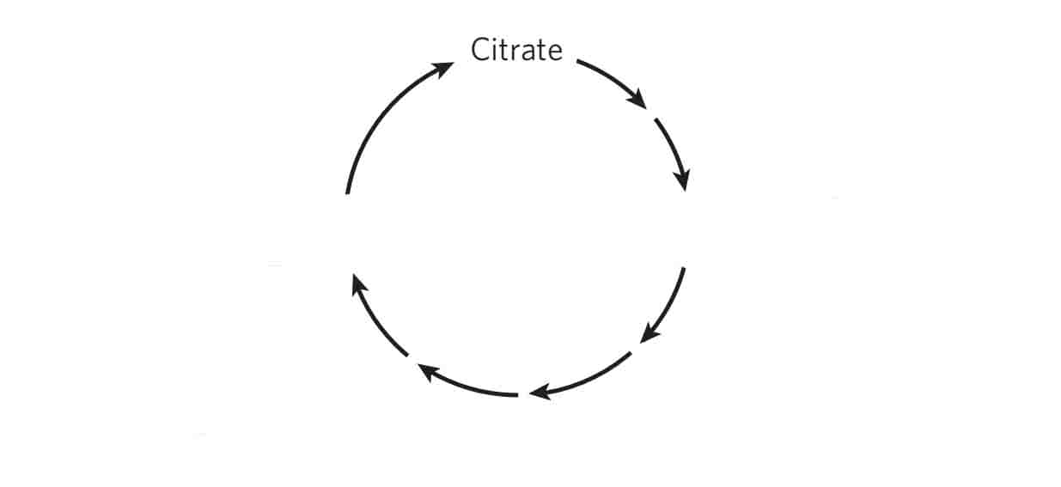
Synthesis of amino acids and nucleotides
Histidine
PRPP
Glycine
Serine
IMP
Cysteine
Tryptophan
3-phosphoglycerate
glucose 6-phosphate
Phenylalanine
phosphoenolpyruvate
AMP
Tyrosine
Alanine
GMP
urea cycle
Valine
pyruvate
Leucine
ATP
Isoleucine
GTP
Asparagine
CTP
Methionine
UTP
Threonine
Aspartate
oxaloacetate
α-ketoglutarate
Lysine
dATP
Glutamine
dGTP
Proline
Glutamate
dCTP
dTTP
Arginine

Slide 4
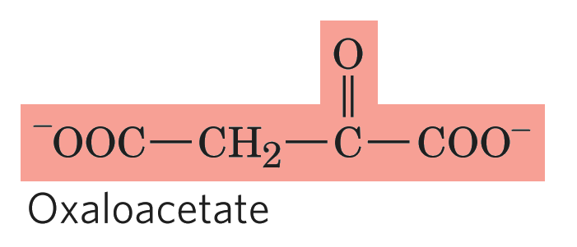
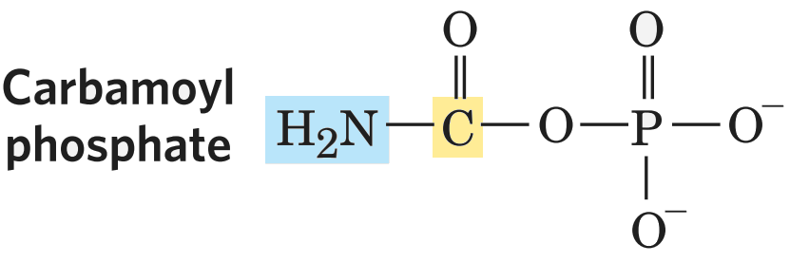
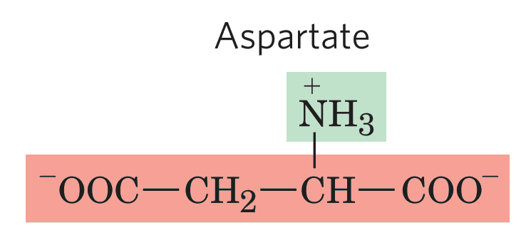
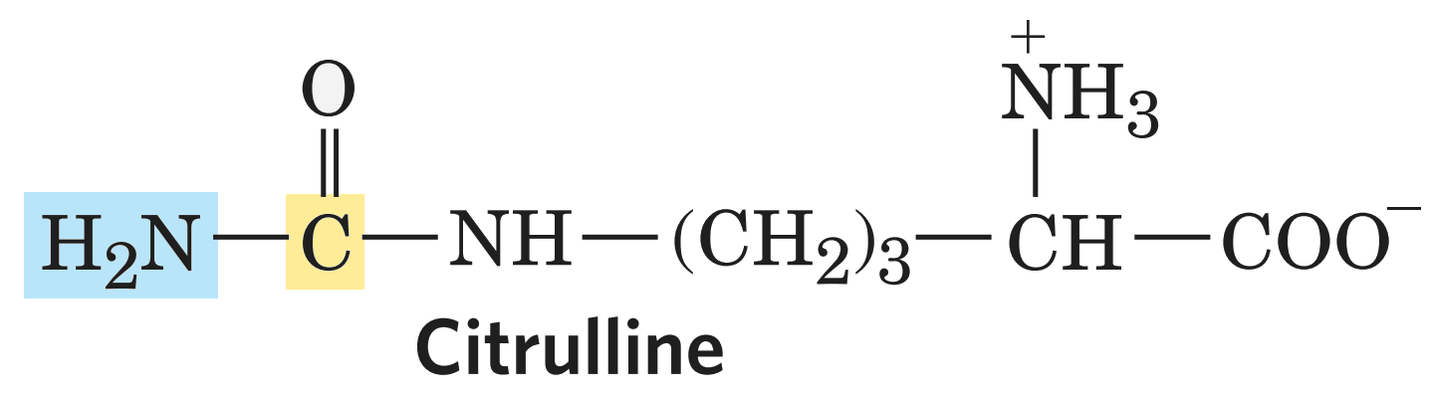
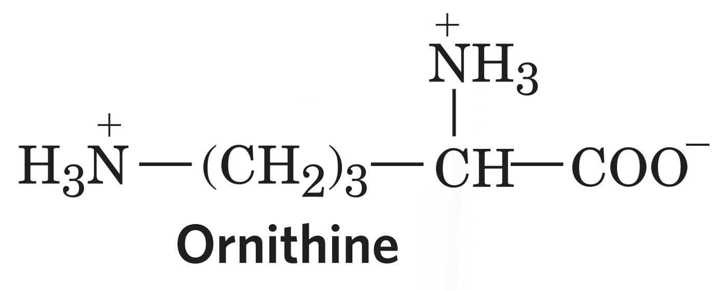
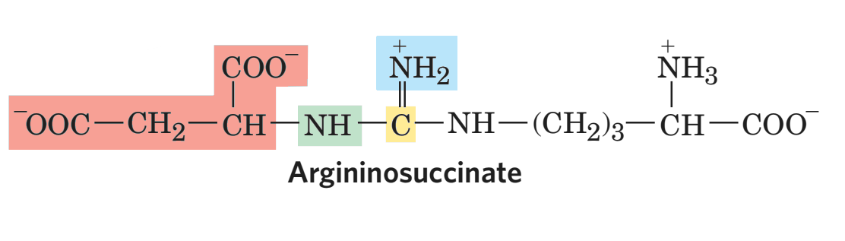
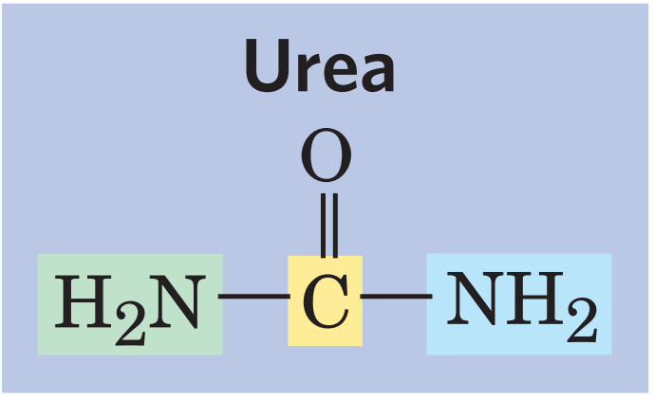
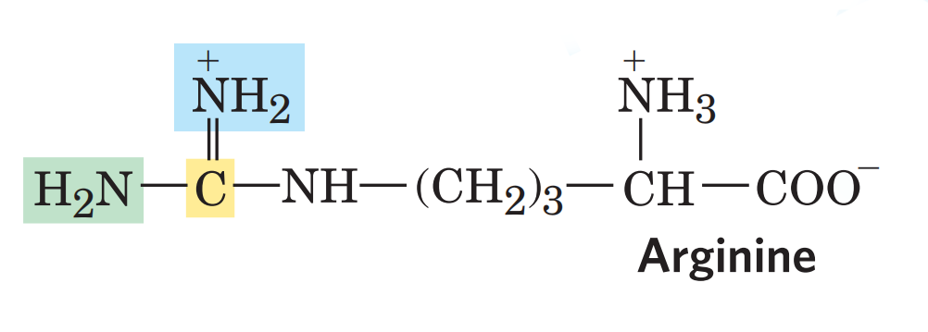
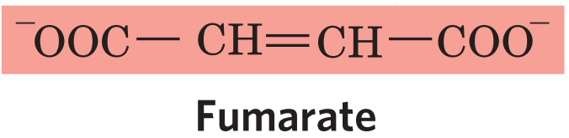
urea cycle
mitochondiral matrix
carbamoyl phosphate synthatase I
glutamate
NH4+
glutamate dehydrogenase
HCO₃
2ATP
2ADP+Pi
aspartate aminotransferase
α-ketoglutarate
Pi
ATP
AMP+PPi
cytosol
H₂O

Slide 5
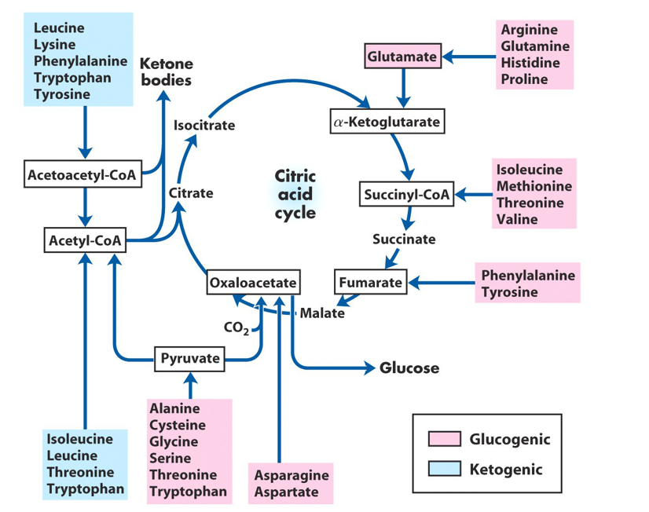
fate of carbon skeletons of amino acids
glucogenic amino acids:
Alanine,Cystenine,Serine,aparagine,aspartate,valine,methionine,proline,histidine,argnine
Both glucogenic and ketogenic amino acids:
Isoleucine,phenylalanine,tyrosine, tryptophan,threonine
ketogenic amino acid:
Leucine,lysine

Slide 6
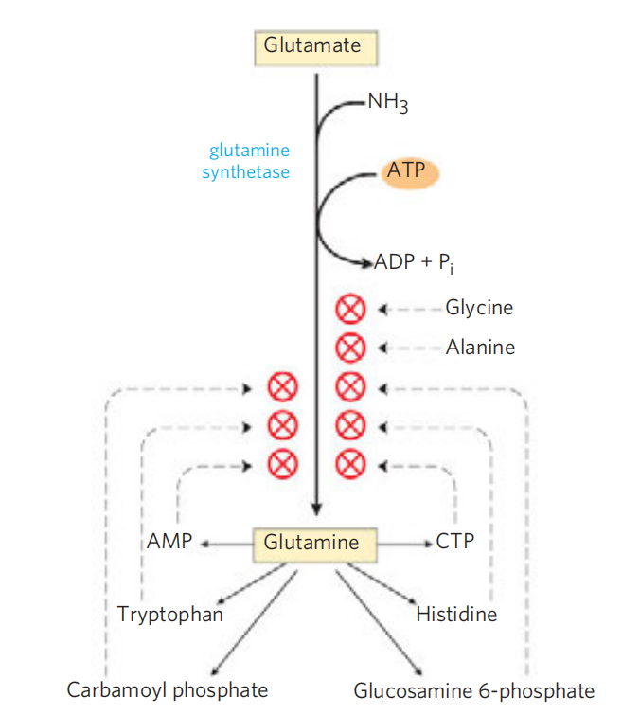
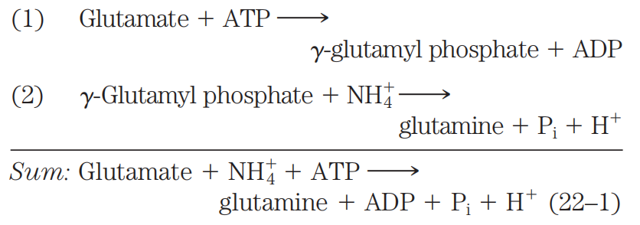
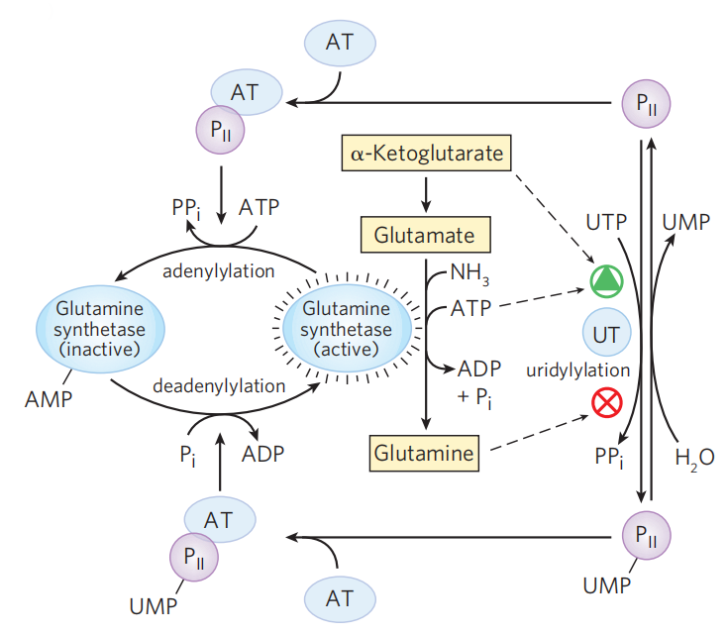
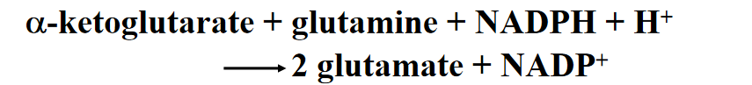
synthesis of glutamine and its regulation
In bacteria and plant,the side chain amino group of Gln is further transferred to a-ketoglutarate to form Glu in a reaction catalyzed by glutamate synthase.
AT-adenyltransferase

Slide 7
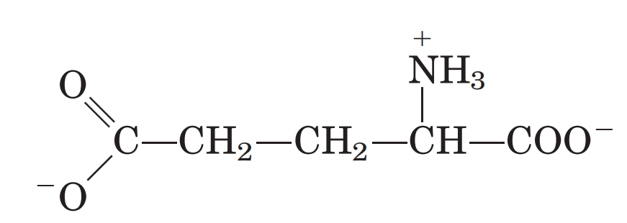
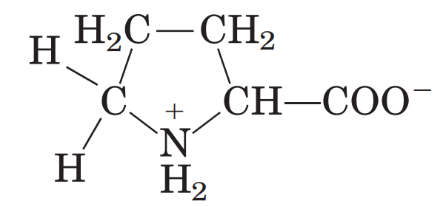
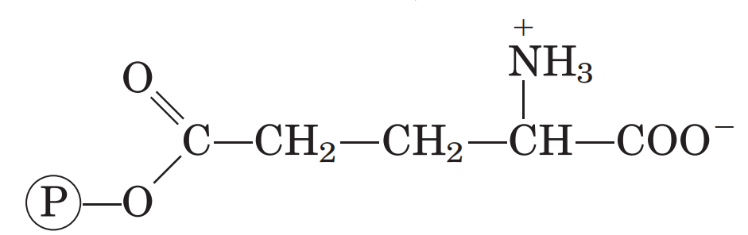
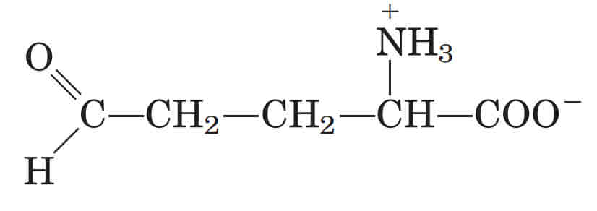
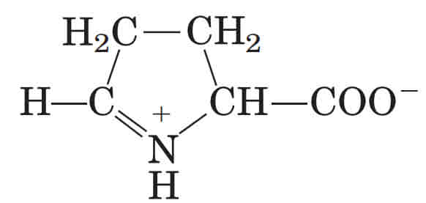
glutamate
ATP
glutamate
kinase
ADP
γ-glutamylphosphate
Proline
NAD(P)H+H⁺
NAD(P)H+H⁺
pyrroline carboxylate
reductase
γ-glutamyl
phosphate
reductase
NAD(P)⁺
NAD(P)⁺
Pi
glutamate γ-semialdehyde
Δ¹-pyrroline-5-carboxylate

Slide 8
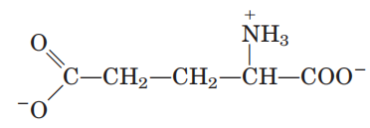
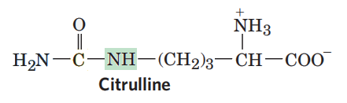
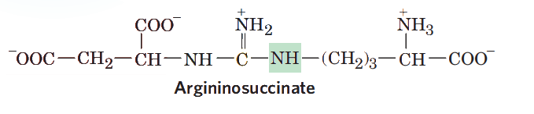
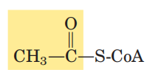
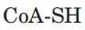
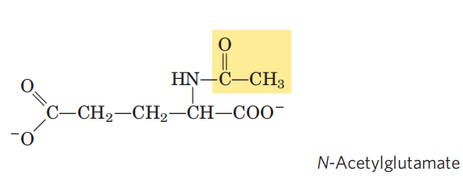
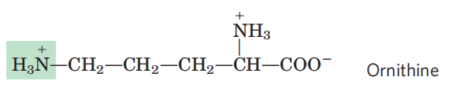
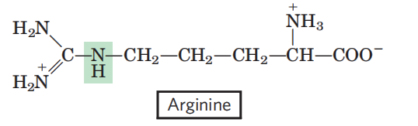
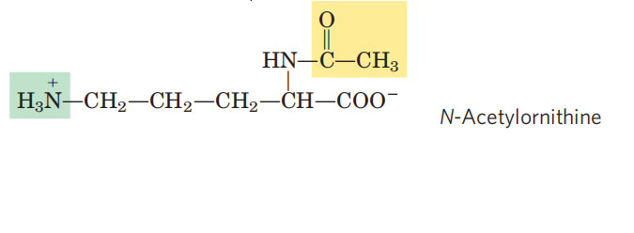
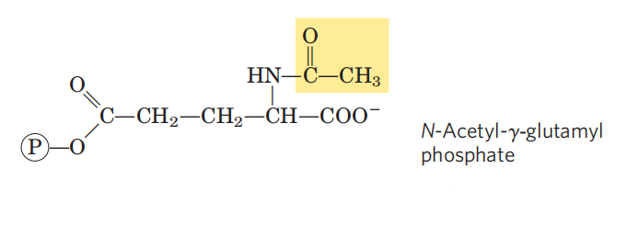
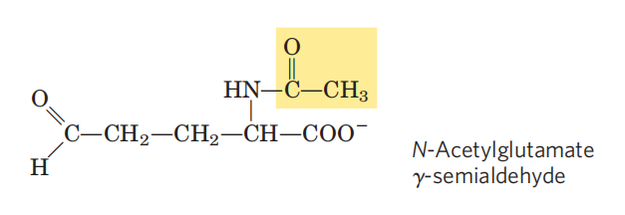
Asp+ATP
AMP+PPi
acetylglutamte synthase
argininosuccinate synthetase
orinithine
carbamoyl
transferase
Pi
carbamoyl phosphate
argininosuccinase
fumarate
CH₃COO⁻
N-acetyl glutamate
kinase
ATP
N-acetylorinithinase
H₂O
ADP
α-ketoglutarate
aminotransferase
glutamate
NAD(P)H+H⁺
NAD(P)⁺
N-acetyl glutamte
dehydrogenase
Pi

Slide 9
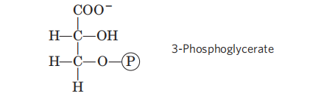
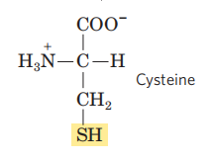

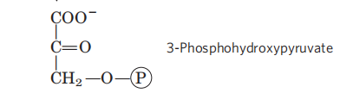
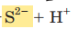
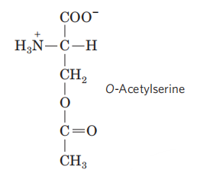
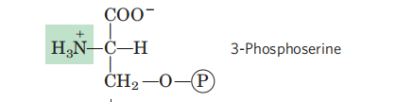
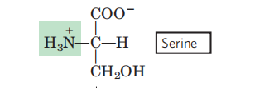
phosphoglycerate
dehydrogenase
NAD⁺
NADH+H⁺
O-acetylserine
lyase
CH₃COO⁻
H₂O
serine hydroxymethyl
transferase
N₅,N₁₀-Methylene H₄ folate
glutamate
phosphoserine
aminotransferase
H₄ folate
α-ketoglutarate
phosphoserine phosphatase
CoA-SH
serine acetyltransferase
acetyl-CoA
H₂O
Pi

Slide 10
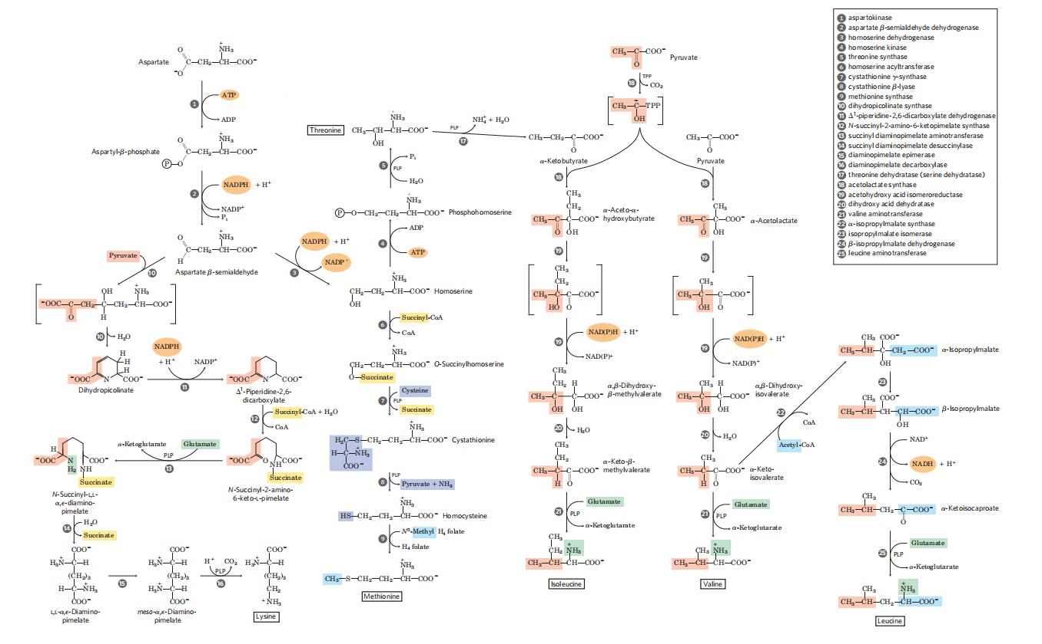

Slide 11
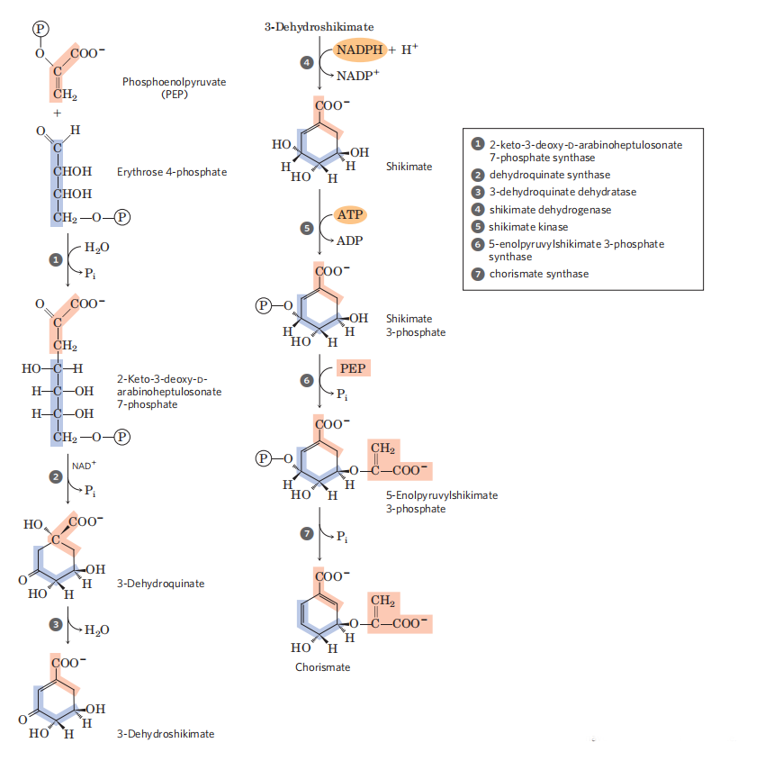
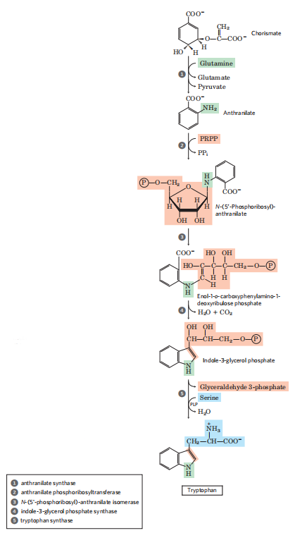
synthesis of trptophan

Slide 12
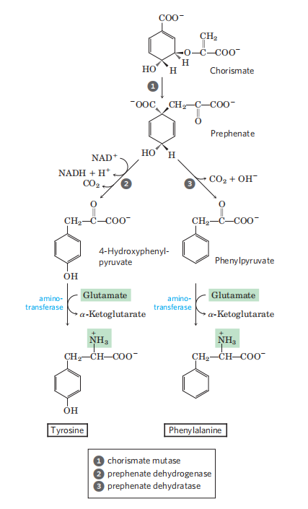
synthesis of tyrosine and phenylalanine

Slide 13
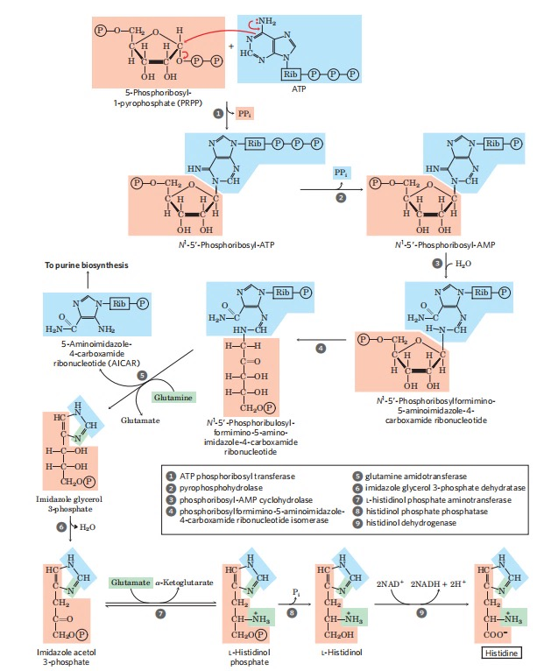
synthesis of Histidine

Slide 14
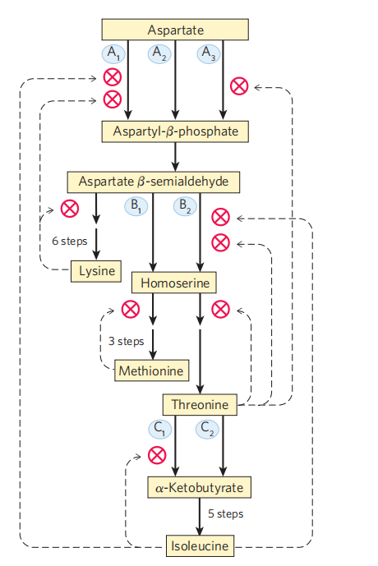
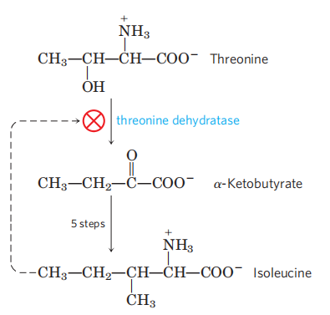
feedback inhibition found in amino acid biosynthesis
The first case of allosteric feedback inhibition was discovered in studying Ile biosynthesis in E. coli.
The enzyme catalyzing the first reaction (threonine dehydratase) is inhibited by the end product (Ile) in a synthetic pathway.
In branching pathways leading to the synthesis of multiple end products from common precursors,several forms of feedback inhibition mechanisms are used to coordinately regulate the synthesis of all the amino acids.

Slide 15
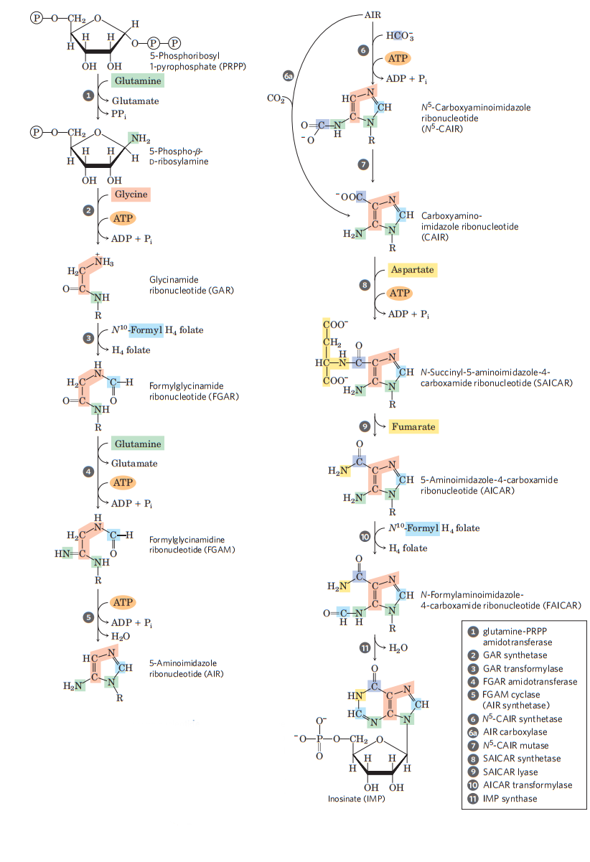
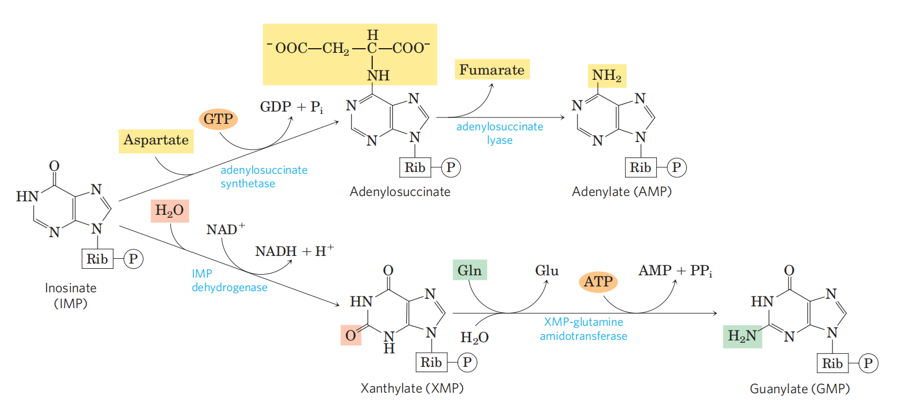
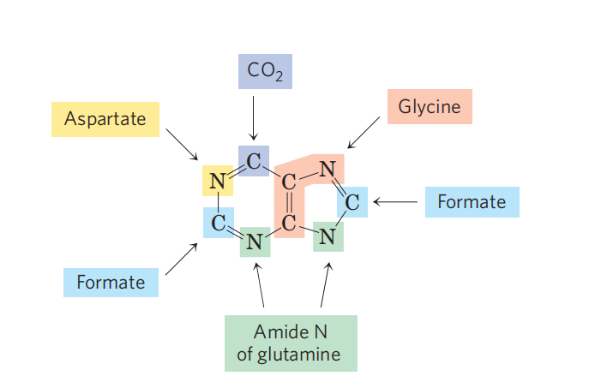
de novo synthesis of purine

Slide 16
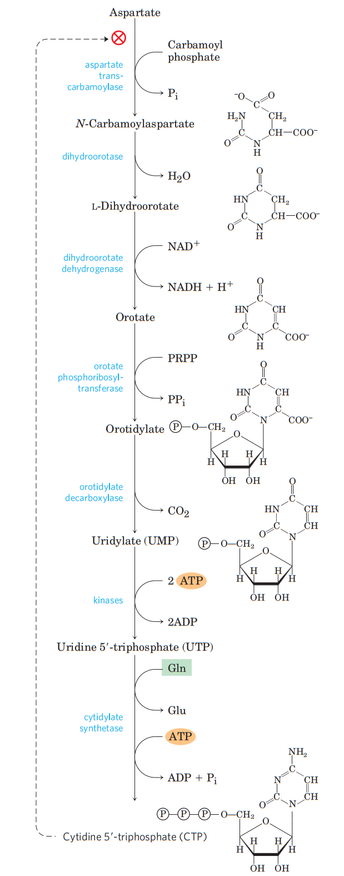
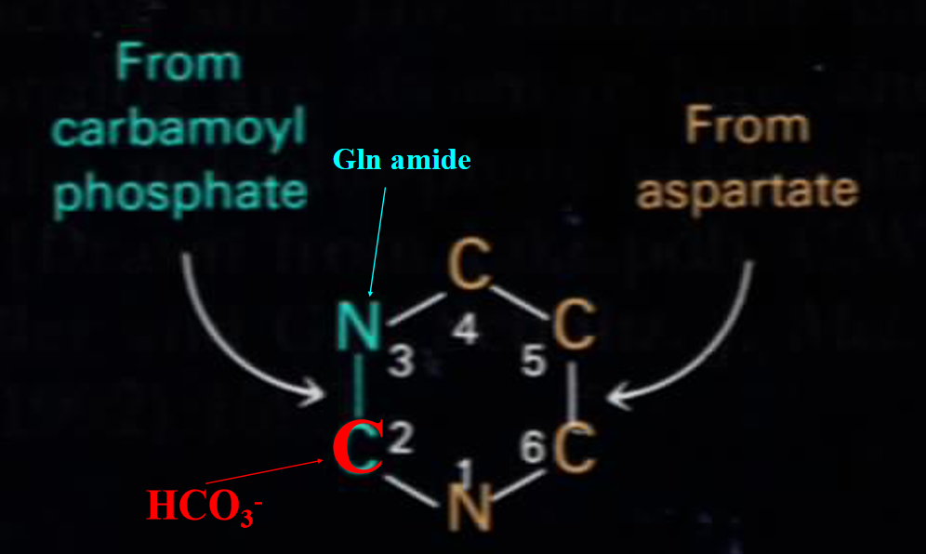
de novo synthesis of pyrimidine

Slide 17

synthesis of deoxyribonucleotides from nucleotides at NDP levels
NDPs are converted to dNDPs with the catalysis of ribonucleotide reductase, with electrons ultimately coming from NADPH.

Slide 18



ribonucleotide reductase
Ribonucleotide reductase is a tetramer of two different subunits,R1 and R2,existing as R1 dimer and R2 dimer.R1 is the catalytic subunit and has two regulatory site and two Cys residual central to reaction mechanism.R2 is the radical-generation subunit, containing a Tyr radical and a Fe³⁺-Fe³⁺ binuclear center.
R2 dimer

Slide 19

regulation of ribonucleotide reductase
At the overall enzymatic activity site: when ATP binds, the enzyme is activated; when dATP binds, the enzyme is inactivated.
At the substrate specificity site:
when dATP or ATP binds, reduction of CDP and UDP is favored;
when dTTP binds, reduction of GDP is favored (and the reduction of CDP and UDP is inhibited);
when dGTP binds, reduction of ADP is favored.
Both substrate specificity and the overall enzymatic
activity of ribonucleotide reductase are regulated to
balance the biosynthesis of all nucleotides.

Slide 20

mechanism of ribonucleotide reductase
A proposed mechanism for converting a NDP to a dNDP by ribonucleotide reductase:
The radical property of the enzyme is transiently ransferred to the substrate; the presence of the radical at C-3 stabilizes the carbon cation formed at C-2.

Slide 21


synthesis of dTTP
dTMP is derived from dUMP via a methylation reaction using N5, N10-methylenetetrahydrofolate as donors of both one-carbon unit and electrons.

Slide 22

catabolism of pyrimidine
The degradation of thymine produces methylmalonyl-CoA, which can be converted to succinyl-CoA (a citric acid cycle intermediate) by the catalysis of a mutase.
The degradation of uracil and cytidine produces malonyl-CoA, which is the precursor for fatty acid biosynthesis.
To a limited extent, catabolism of pyrimidine nucleotides contributes to the energy metabolism of the cell.
The end product of pyrimidine degradation is urea.
urea
urea cycle
succinyl-CoA

Slide 23

catabolsm of purine
Uric acid is the excreted end product of purine catabolism in humans and many other animals.
Overproduction of uric acid was revealed to cause gout.
Uric acid can be further converted to allantoin, allantoate, urea or NH4+ in various animals.
For adenosine, the amino group is hydrolyzed before the ribose group is removed.
For guanosine, the amino group is hydrolyzed after the ribose group is removed.
Xanthine oxidase, having multiple cofactors (including an FAD, a Mo complex, four different Fe-S clusters), catalyzes the O2-dependent conversion of hypoxanthine to xanthine and xanthine to uric acid.

Slide 24

further process with uric acid in various animals

